Slide 1
Chapter 10
Liquids and Solids

Slide 2
10.1 Intermolecular Forces
10.2 The Liquid State
10.3 An Introduction to Structures and Types of Solids
10.5 Carbon: Network Atomic Solids
10.8 Vapor Pressure and Changes of State
10.9 Phase Diagrams (no longer on AP, but still included)

Slide 3
Intramolecular Bonding
“Within” the molecule.
Molecules are formed by sharing electrons between the atoms.

Slide 4
Intermolecular Forces
Forces that occur between molecules.
Dipole–dipole forces
Hydrogen bonding
London dispersion forces
Intramolecular bonds are stronger than intermolecular forces.
Ion-ion is stronger than any intermolecular force

Slide 5
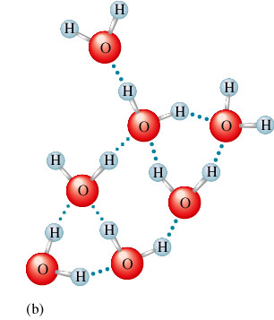
Hydrogen Bonding in Water
Blue dotted lines are the intermolecular forces between the water molecules.

Slide 6
Phase Changes
When a substance changes from solid to liquid to gas, the molecules remain intact.
The changes in state are due to changes in the forces among molecules rather than in those within the molecules.

Slide 7
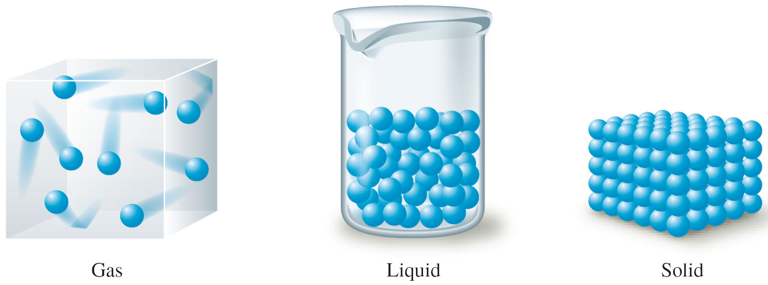
Schematic Representations of the Three States of Matter

Slide 8
Phase Changes
Solid to Liquid
As energy is added, the motions of the molecules increase, and they eventually achieve the greater movement and disorder characteristic of a liquid.
Liquid to Gas
As more energy is added, the gaseous state is eventually reached, with the individual molecules far apart and interacting relatively little.

Slide 9
1. Hydrogen Bonding (strongest)
The hydrogen bond is a special dipole-dipole interaction between the hydrogen atom in a polar N-H, O-H, or F-H bond and an electronegative O, N, or F atom. IT IS NOT A BOND.

Slide 10
Hydrogen Bonding

Slide 11
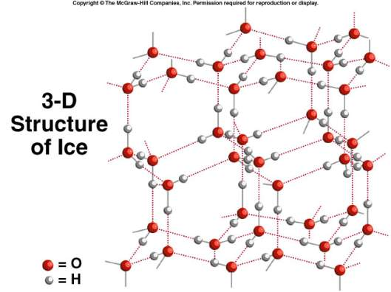
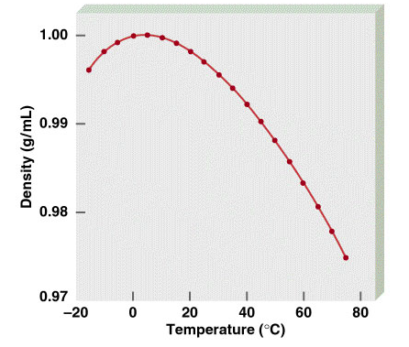
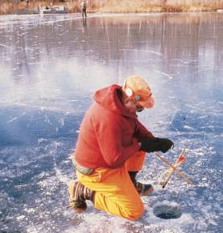
Water is a Unique Substance
Maximum Density
40C
Density of Water
Ice is less dense than water
11.3

Slide 12
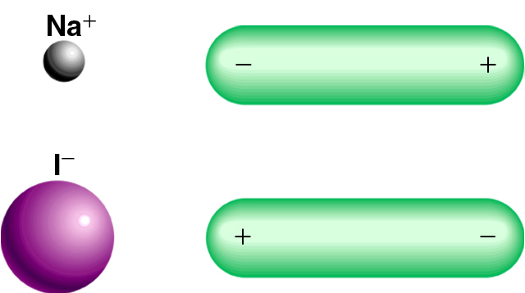
Types of Intermolecular Forces
2. Ion-Dipole Forces
Attractive forces between an ion and a polar molecule
Ion-Dipole Interaction
11.2

Slide 13
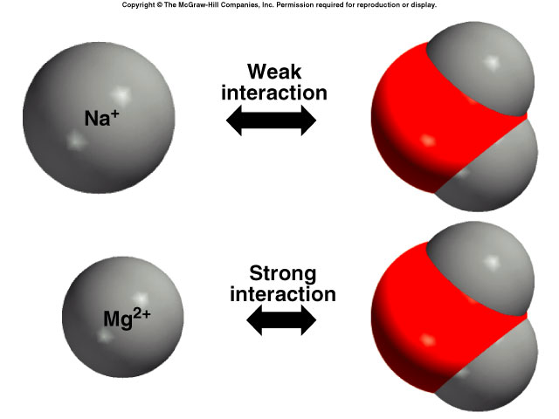
11.2

Slide 14
3. Dipole-Dipole Forces
Dipole moment – molecules with polar bonds can attract each other electrostatically. They line up so that the positive and negative ends are close to each other.
Only about 1% as strong as covalent or ionic bonds.

Slide 15
Dipole-Dipole Forces

Slide 16
4. London Dispersion Forces (weakest)
Instantaneous dipole that occurs accidentally in a given atom induces a similar dipole in a neighboring atom.
Significant in large atoms/molecules.
Occurs in all molecules, including nonpolar ones.

Slide 17
London Dispersion Forces

Slide 18
What type(s) of intermolecular forces exist between each of the following molecules?
HBr
HBr is a polar molecule: dipole-dipole forces. There are also dispersion forces between HBr molecules.
CH₄
CH₄ is nonpolar: dispersion forces.
S
O
O
SO₂
SO₂ is a polar molecule: dipole-dipole forces. There are also dispersion forces between SO₂ molecules.
11.2

Slide 19
Concept Check
Which molecule is capable of forming stronger intermolecular forces?
N₂ H₂O
Explain.
Notes:
H₂O has the stronger intermolecular forces because it exhibits hydrogen bonding, whereas N₂ only exhibits London dispersion forces.

Slide 20
Melting and Boiling Points
In general, the stronger the intermolecular forces, the higher the melting and boiling points.

Slide 21
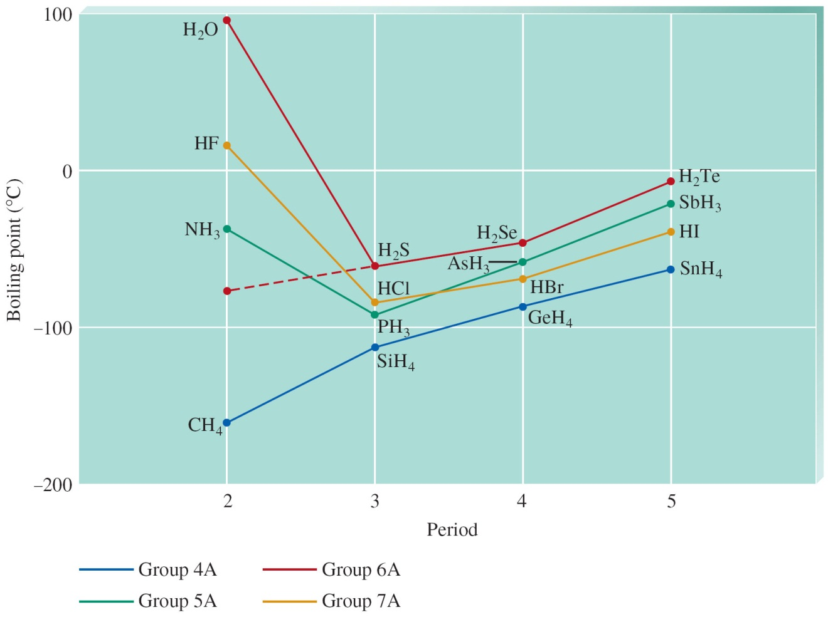
The Boiling Points of the Covalent Hydrides of the Elements in Groups 4A, 5A, 6A, and 7A

Slide 22
Concept Check
Draw two Lewis structures for the formula C₂H₆O and compare the boiling points of the two molecules.
Notes:
One Lewis structure could be ethanol and one Lewis structure could be dimethyl ether. Ethanol will have a higher boiling point than dimethyl ether because ethanol exhibits hydrogen bonding and dimethyl ether exhibits dipole-dipole interactions. Hydrogen bonding is an especially strong type of dipole-dipole interaction and will thus raise the boiling point of ethanol.

Slide 23
Liquids
Low compressibility, lack of rigidity, and high density compared with gases.
Surface tension – resistance of a liquid to an increase in its surface area:
Liquids with large intermolecular forces tend to have high surface tensions.

Slide 24
Liquids
Capillary action – spontaneous rising of a liquid in a narrow tube:
Cohesive forces – intermolecular forces among the molecules of the liquid.
Adhesive forces – forces between the liquid molecules and their container.

Slide 25
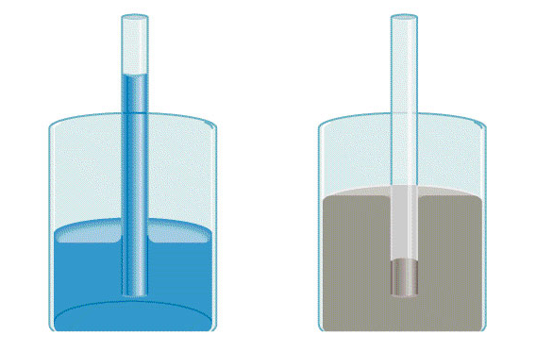
Properties of Liquids
Cohesion is the intermolecular attraction between like molecules
Adhesion is an attraction between unlike molecules
Adhesion
attracted to glass
Cohesion
attracted to each other
11.3

Slide 26
Liquids
Viscosity – measure of a liquid’s resistance to flow:
Liquids with large intermolecular forces or molecular complexity tend to be highly viscous.

Slide 27
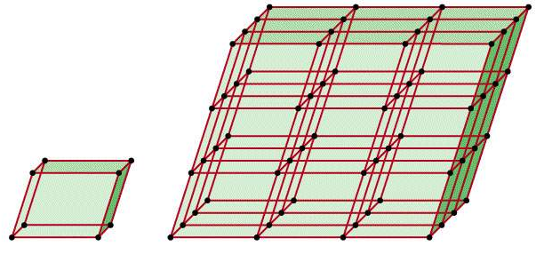
A crystalline solid possesses rigid and long-range order. In a crystalline solid, atoms, molecules or ions occupy specific (predictable) positions.
An amorphous solid does not possess a well-defined arrangement and long-range molecular order.
A unit cell is the basic repeating structural unit of a crystalline solid.
lattice
point
At lattice points:
Atoms
Molecules
Ions
Unit Cell
Unit cells in 3 dimensions
11.4

Slide 28
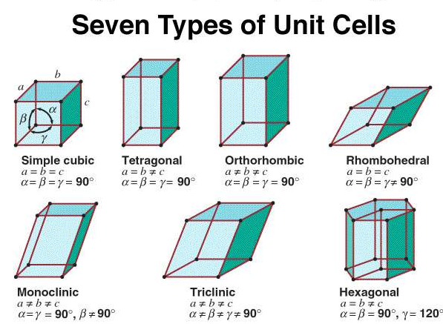
11.4

Slide 29
Types of Crystalline Solids
Ionic Solids – ions at the points of the lattice that describes the structure of the solid. Ion-ion is stronger than all IM forces
Atomic Solids – atoms at the lattice points that describe the structure of the solid. Stronger than IM forces but generally weaker than ion-ion
Molecular Solids – discrete covalently bonded molecules at each of its lattice points. Held together with only IM forces

Slide 30
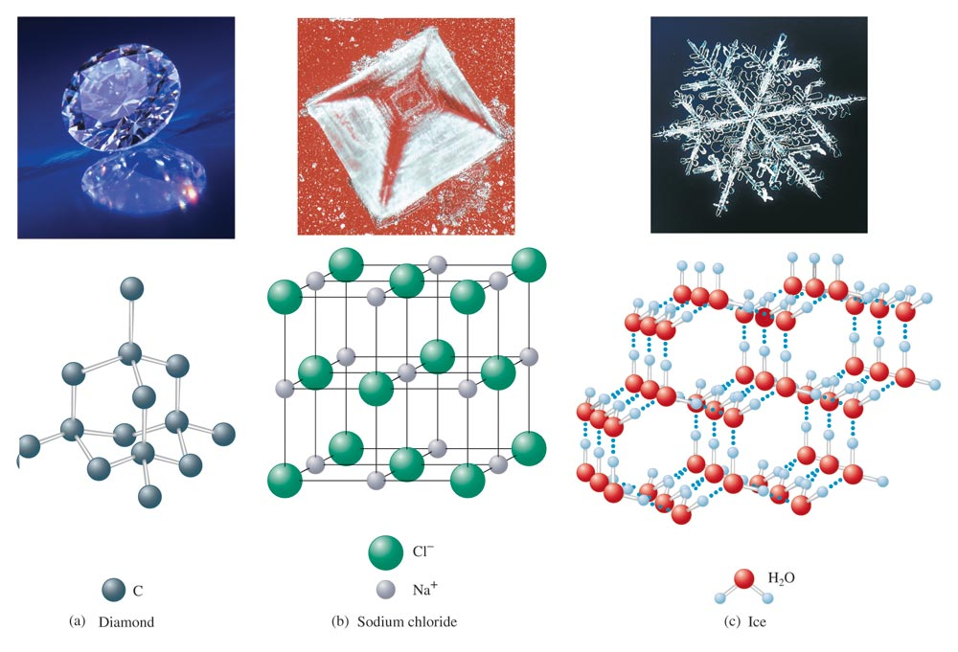
Examples of Three Types of Crystalline Solids

Slide 31
Network Solids

Slide 32
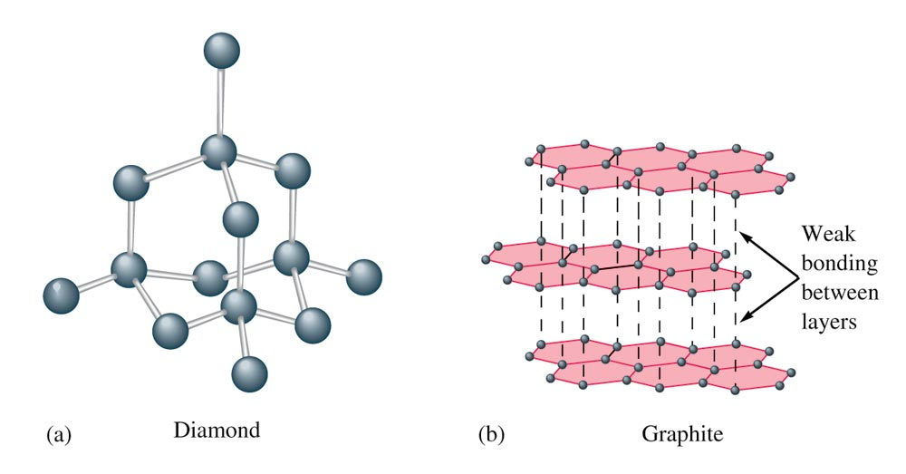
The Structures of Diamond and Graphite

Slide 33
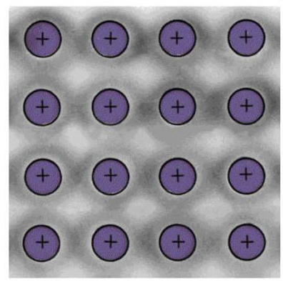
Types of Crystals
Metallic Crystals – Typically weaker than covalent, but can be in the low end of covalent
Lattice points occupied by metal atoms
Held together by metallic bonds
Soft to hard, low to high melting point
Good conductors of heat and electricity
Cross Section of a Metallic Crystal
nucleus &
inner shell e-
mobile “sea”
of e-
11.6

Slide 34
Vapor Pressure
Pressure of the vapor present at equilibrium.
The system is at equilibrium when no net change occurs in the amount of liquid or vapor because the two opposite processes exactly balance each other.

Slide 35
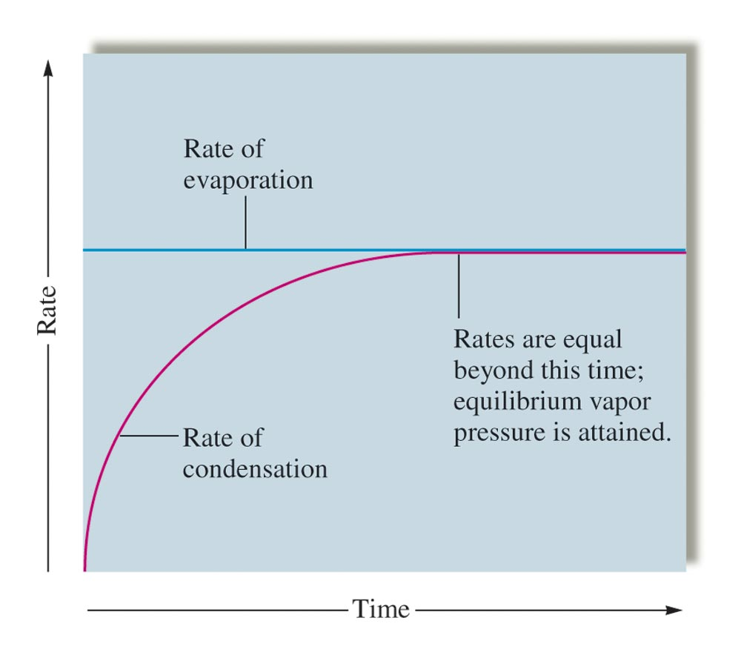
The Rates of Condensation and Evaporation

Slide 36
Concept Check
What is the vapor pressure of water at 100°C? How do you know?
1 atm
Notes:
The vapor pressure of water at 100ºC is 1 atm. You know this because atmospheric pressure is 1 atm and this is the temperature at which we observe water to boil.

Slide 37
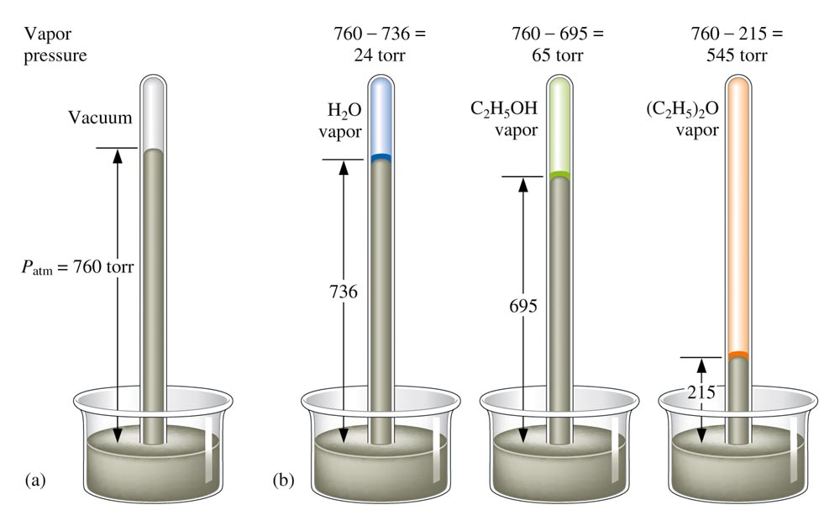
Vapor Pressure

Slide 38
Vapor Pressure
Liquids in which the intermolecular forces are strong have relatively low vapor pressures.
Vapor pressure increases significantly with temperature.

Slide 39
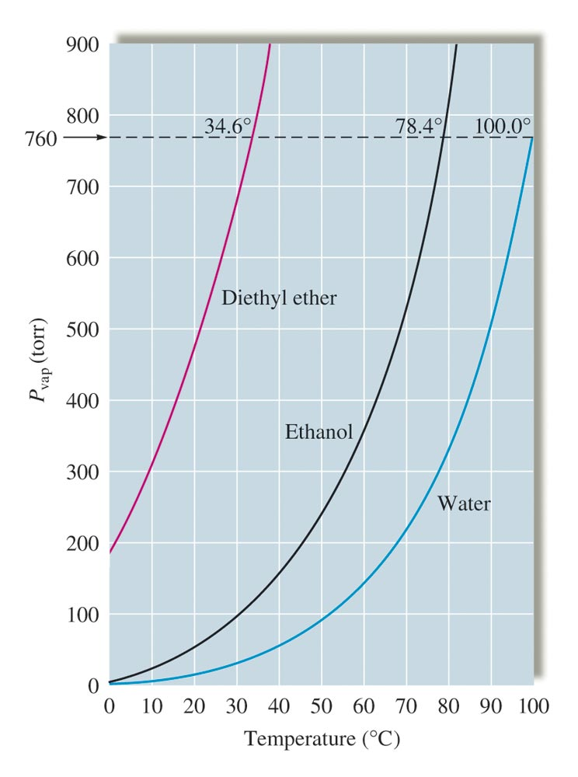
Vapor Pressure vs. Temperature

Slide 40
Changes of State

Slide 41
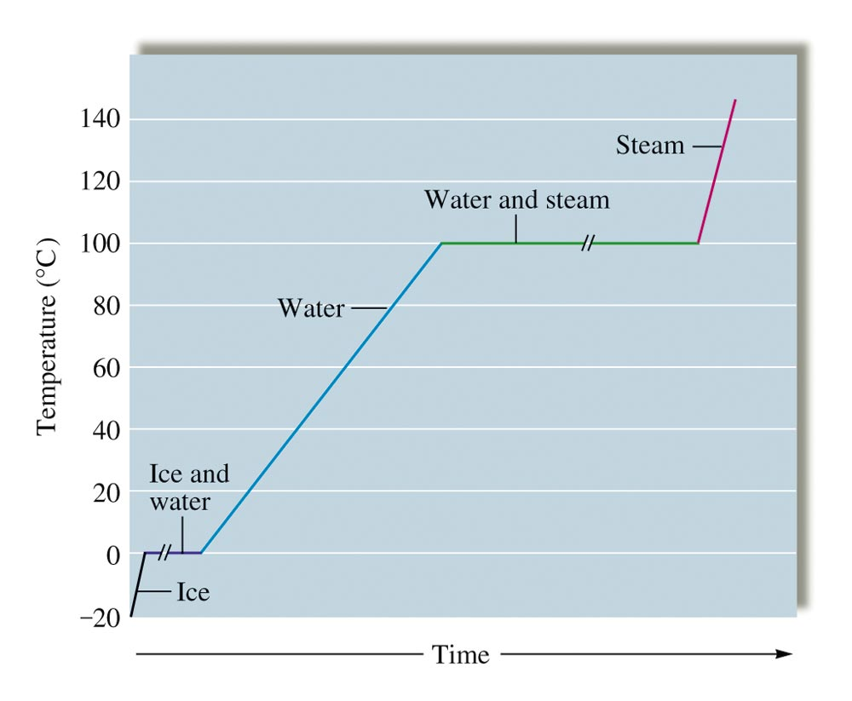
Heating Curve for Water

Slide 42
A convenient way of representing the phases of a substance as a function of temperature and pressure: (not on AP, but on my test!)
Triple point
Critical point
critical temperature (T_{c}) - temperature above which the gas cannot be made to liquefy, no matter how great the applied pressure.
critical pressure (P_{c}) - minimum pressure that must be applied to bring about liquefaction at the critical temperature.
Phase equilibrium lines

Slide 43
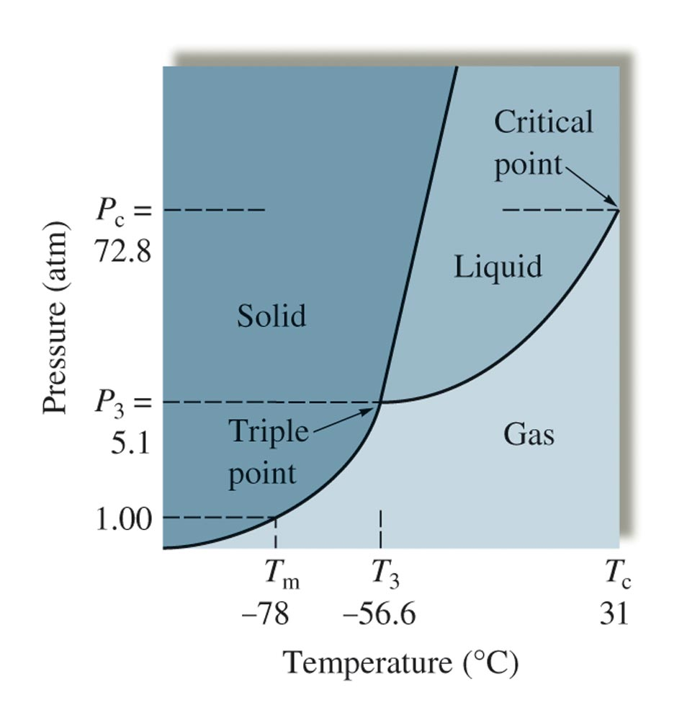
Phase Diagram for Carbon Dioxide

Slide 44
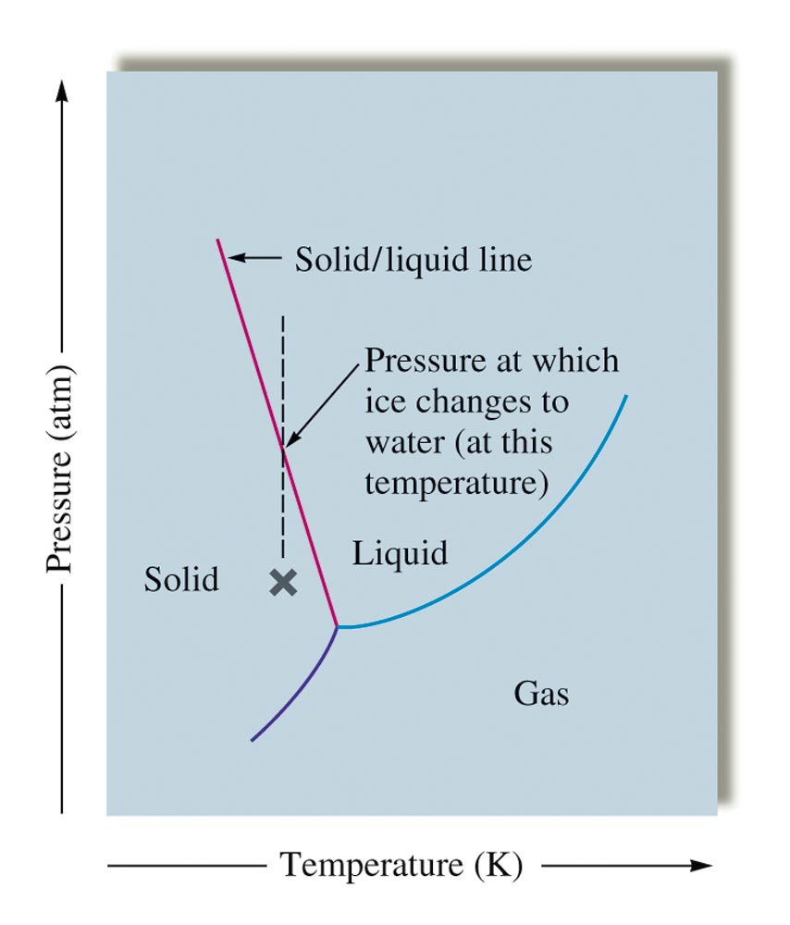
Phase Diagram for Water

Slide 45
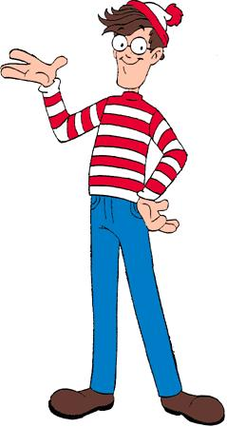
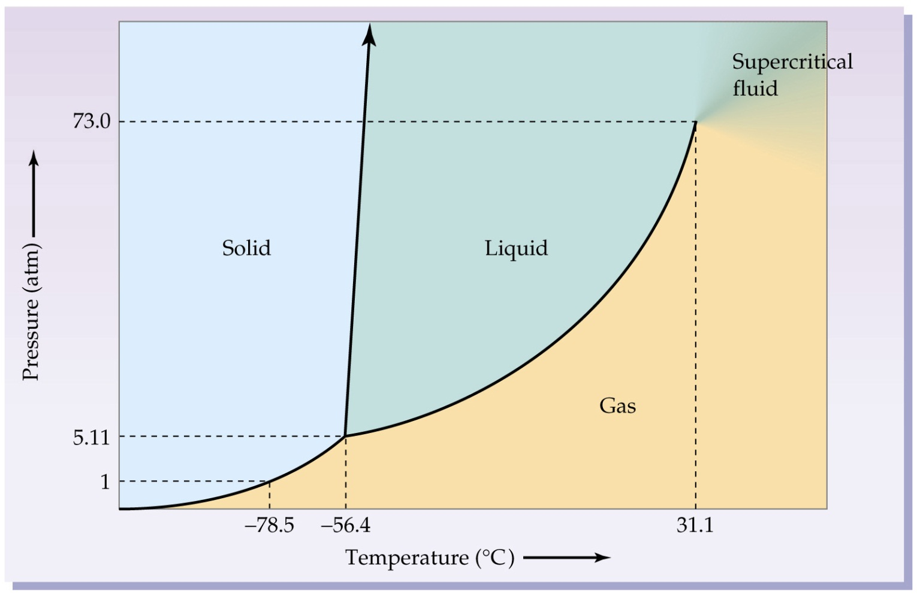
Where’s Waldo?
Can you find…
The Triple Point?
Critical pressure?
Critical temperature?
Where fusion (s -> l) occurs?
Where vaporization (l -> g) occurs?
Melting point (at 1 atm)?
Boiling point (at 6 atm)?
Carbon Dioxide

Slide 46
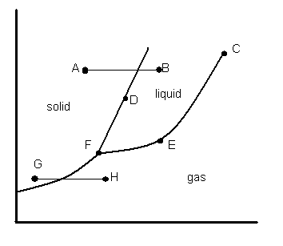

Slide 47
Concept Check
As intermolecular forces increase, what happens to each of the following? Why?
Boiling point
Viscosity
Surface tension
Enthalpy of fusion (solid to liquid)
Freezing point
Vapor pressure
Heat of vaporization (liquid to gas)
Notes:
Boiling point increases
Viscosity increases
Surface tension increases
Enthalpy of fusion increases
Freezing point increases
Vapor pressure decreases
Heat of vaporization increases

